Slide 1
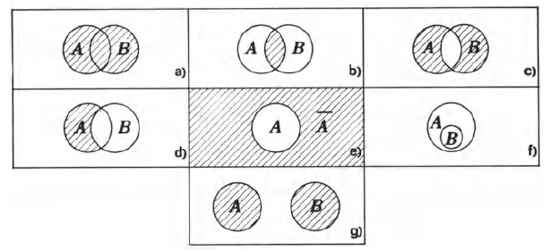




Common Set Theory Notations
a)
(A union B)
d)
(A minus B)
b)
(A intersection B)
e)
(A complement)
f)
B is a subset of A
c)
(symmetric difference of A and B)
g)
A and B are disjoint sets

Slide 2

Independent Events
When multiple events occur, if the outcome of one event DOES NOT affect the outcome of the other events, they are called independent events.
Say, a die is rolled twice. The outcome of the first roll doesn’t affect the second outcome. These two are independent events.
Similarly, if a coin is tossed twice, the outcome of the first toss does not affect that of the second. Hence, these are independent events.
If two events A and B are independent,

Slide 3


Independent Events
A coin is tossed twice. What is the probability of getting two consecutive tails?
Let A denote the event that a head is obtained in the first toss and B denote the event that a head is obtained in the second toss.
Since the coin is fair, P(A) = P(B) = 0.5
We need the probability
Since the two tosses are independent,

Slide 4

Independent Events
What is the probability of drawing a king and a queen consecutively from a deck of 52 cards WITHOUT replacement?
Let A denote the event that a king is drawn first and B denote the event that a queen is drawn second.
Since the deck is fair, P(A) = 4/52 = 1/13 and P(B) = 4/51
We need the probability
Since the two draws are independent,

Slide 5
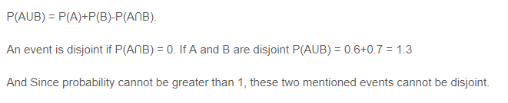
Independent Events

Slide 6

Independent Events

Slide 7
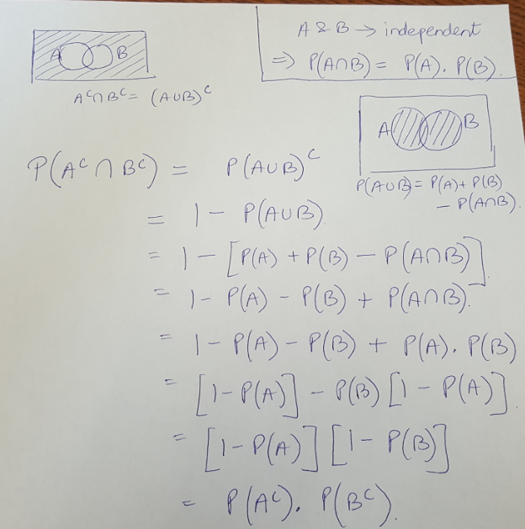
Independent Events
If A and B are two independent events, prove that A^{C} and B^{C} are also independent

